Slide 1
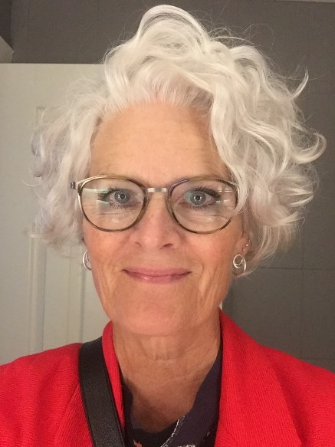




Charlotte Myhre Jensen
PhD, klinisk sygeplejeforsker
Significant challenges in everyday life for patients younger than 60 years
up to three years after hip fracture
– a qualitative investigation
Ortopædkirurgisk Afdeling O, Odense Universitetshospital; Syddansk Universitet, Danmark

Slide 2
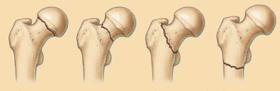
Background–Objectives– Design and Methods – Results - Conclusion
Large body of studies on minor trauma hip fracture management focusing on patients > 65 years
Only scarce litterature on patient experiences – even less on the patients < 60 years
Litterature reviews from 2018 uncovered lack of evidence on longterm needs and experiences and outcomes of patients < 60 years (1,2)
Janes G, Serrant L, Sque M. Silent slips, trips and broken hips in the under 60s: A review of the literature.
IJOTN. 2018
(2) Rogmark C et al. Hip fractures in the non-elderly – Who, why and whither? Injury. 2018

Slide 3
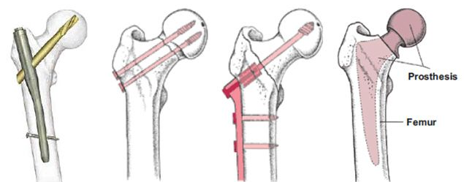
Background – Objectives – Design and Methods – Results - Conclusion
The aim of this study is to illuminate
the lived experience of the path of recovery
in young and middle-aged adults
sustaining a hip-fracture
in order to guide future healthcare services.

Slide 4
Background – Objectives – Design and Methods – Results - Conclusion
A qualitative study design
Participants purposively sampled from a multi-centre study (in Denmark and Sweden) (3)
Narrative interviews with 19 patients < 60 years
Native speaking interviewers – cross-checking of interviews by a third party to ensure continuity and congruence
Interviews were transcribed verbatim
Analysis of data using specific model of interpretation (4)
(3) Strøm Rönnquist S, Viberg B, Kristensen M, Fladmose Madsen C, Akesson K, Overgaard S, Palm H, Rogmark C.
High Prevalence of Osteopenia and Osteoporosis in Hip Fracture Patients under 60 Years
A Prospective Study with Bone Mineral Density Assessment at the Time of the Fracture. AAOS 2019
(4) Lindseth A and Norberg A. A phenomenological hermeneutical method for researching lived experience. SJCS.2004

Slide 5
Background – Objectives – Design and Methods – Results - Conclusion
Demografics

Slide 6
Background – Objectives – Design and Methods – Results - Conclusion
Patient experiences
”a sentiment of becoming old, from one day to another…… the body becoming more feeble than before ” (M, 57yrs)
”being looked upon as a person with a sudden progressive symptom and a burden by employees and colleagues” (W, 54 yrs)
”being neglected when articulating fears and being forced to become one’s own health advocate” (W, 34 yrs)
”…routine driven healthcare system guided by the well-established notion that incurring a hip fracture affects mostly elderly..but I need individualized rehabilitation” (W, 52 yrs)
”recurrent stiffness, pain and reduced physical abilities creates a need for margins, never before required” (M, 57 yrs)
”become more afraid of experiencing a new fall and subsequent fracture, resulting in an increased wariness” (M, 56 yrs)
M = man ; W= woman

Slide 7
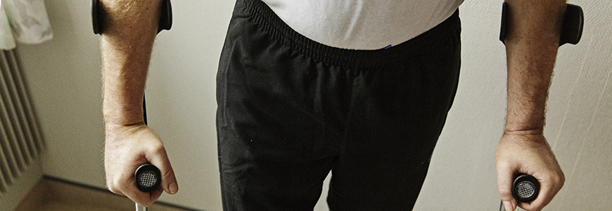
Background – Objectives – Design and Methods – Results - Conclusion
Significant challenges in everyday life for patients younger than 60 years up to three years after hip fracture
Hip fracture management of today is experienced to be targeted at the older patients
The patients request for rehabilitation programs to be targeted and individualized towards younger adults needs in order to strengthen their path of recovery

Slide 8

Charlotte Myhre Jensen PostDoc, RN; Danmark
Hilda Svensson PostDoc, PHN; Sverige
Sebastian Strøm Rönnquist PhD-student, MD; Danmark
Søren Overgaard Professor, MD; Danmark
Cecilia Rogmark Associate Professor, MD; Sverige

