Slide 1
E-book about Nursing for the orthopaedic surgical patient
In a common national project
the Danish orthopaedic surgical wards write an
Gitte Schmidt, uddannelsesansvarlig sygeplejerske, Ortopædkirurgi, Aarhus Universitetshospital
Karen Schmøkel, leder af Forskningsenheden, Center for Planlagt Kirurgi, Regionshospitalet Silkeborg

Slide 2
Editorial group
North Denmark Region
Karin Bundgaard, Ass. Professor, PhD, MScN, RN
Central Denmark Region
Gitte Schmidt, nurse responsible for education, cand. pæd., RN
Karen Schmøkel, Head of Interdisciplinary Research Unit, MScN, RN
Region of Southern Denmark
Charlotte Myhre Jensen, Clinical Research Nurse, PhD, PostDoc, NR
Region Zealand
Trine Tvedegaard Jakobsen, Clinical Nurse Specialist, MKS, RN
Capital Region of Denmark
Winnie Schmelling, Clinical Nurse Specialist, SD, Master of Pain Science and Multidisciplinary Pain Management, RN

Slide 3
Background
Free and easily available evidence-based knowledge
Use put into practice
High quality in nursing
In Denmark we lacked updated textbooks focusing on nursing for selected orthopaedic surgical patient groups. Textbooks which presented evidence-based and clinical relevant knowledge in an easily available form.
In 2019 we presented the idea to VIDOKS.

Slide 4
Purpose
That nursing students and newly graduated/newly appointed nurses in orthopaedic surgical wards in Denmark have free access to an E-book with new, evidence-based and clinical relevant knowledge about nursing for the orthopaedic surgical patient.

Slide 5
Organisation
Steering Committee
VIDOKS Center Council
Editorial group
Representation from
all over Denmark
Author team
Author team
Author team
Author team
Author team

Slide 6
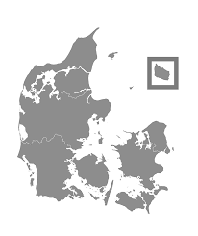
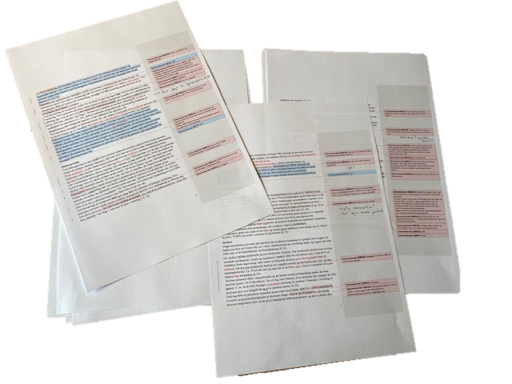
Author teams/peer review ”Nursing for orthopaedic surgical patients who have had back surgery”
Authors:
Competent clinicians
Nurses with academic skill set.
Peer reviewers:
Competent clinicians
Nurses with academic skill set.

Slide 7
Process/expected results
Start June 2019
Author teams start writing process Feb. 2020
CORONA
Delivery of chapters and peer review Oct. 2021
Editing
Nov., Dec. 2021
Launching of E-book April 2022
Expected results:
That nursing students and newly graduated/newly appointed nurses in orthopaedic surgical wards in Denmark have free access to an E-book with new, evidence-based and clinical relevant knowledge about nursing for the orthopaedic surgical patient.
We already see:
Cooperation/network nationally
Insight into different practice
That we have given the authors a huge task!

Slide 8
Perspective
The E-book will be a dynamic document which will require continuous revision
The E-book can be expanded with the chapters practice demands
The E-book can utilise the technology far more in the versions to come

Slide 9

Thank you to…
VIDOKS http://www.vidoks.dk/
Nationalt Videnscenter for Ortopædkirurgisk Sygepleje
FSOS https://dsr.dk/fs/fs26
Fagligt selskab for Ortopædkirurgiske Sygeplejersker
Nurse managers from the orthopaedic surgical wards in Denmark
All the nurses around the country who spend a lot of time writing the chapters – it is a huge task!!
You for your attention

