Slide 1
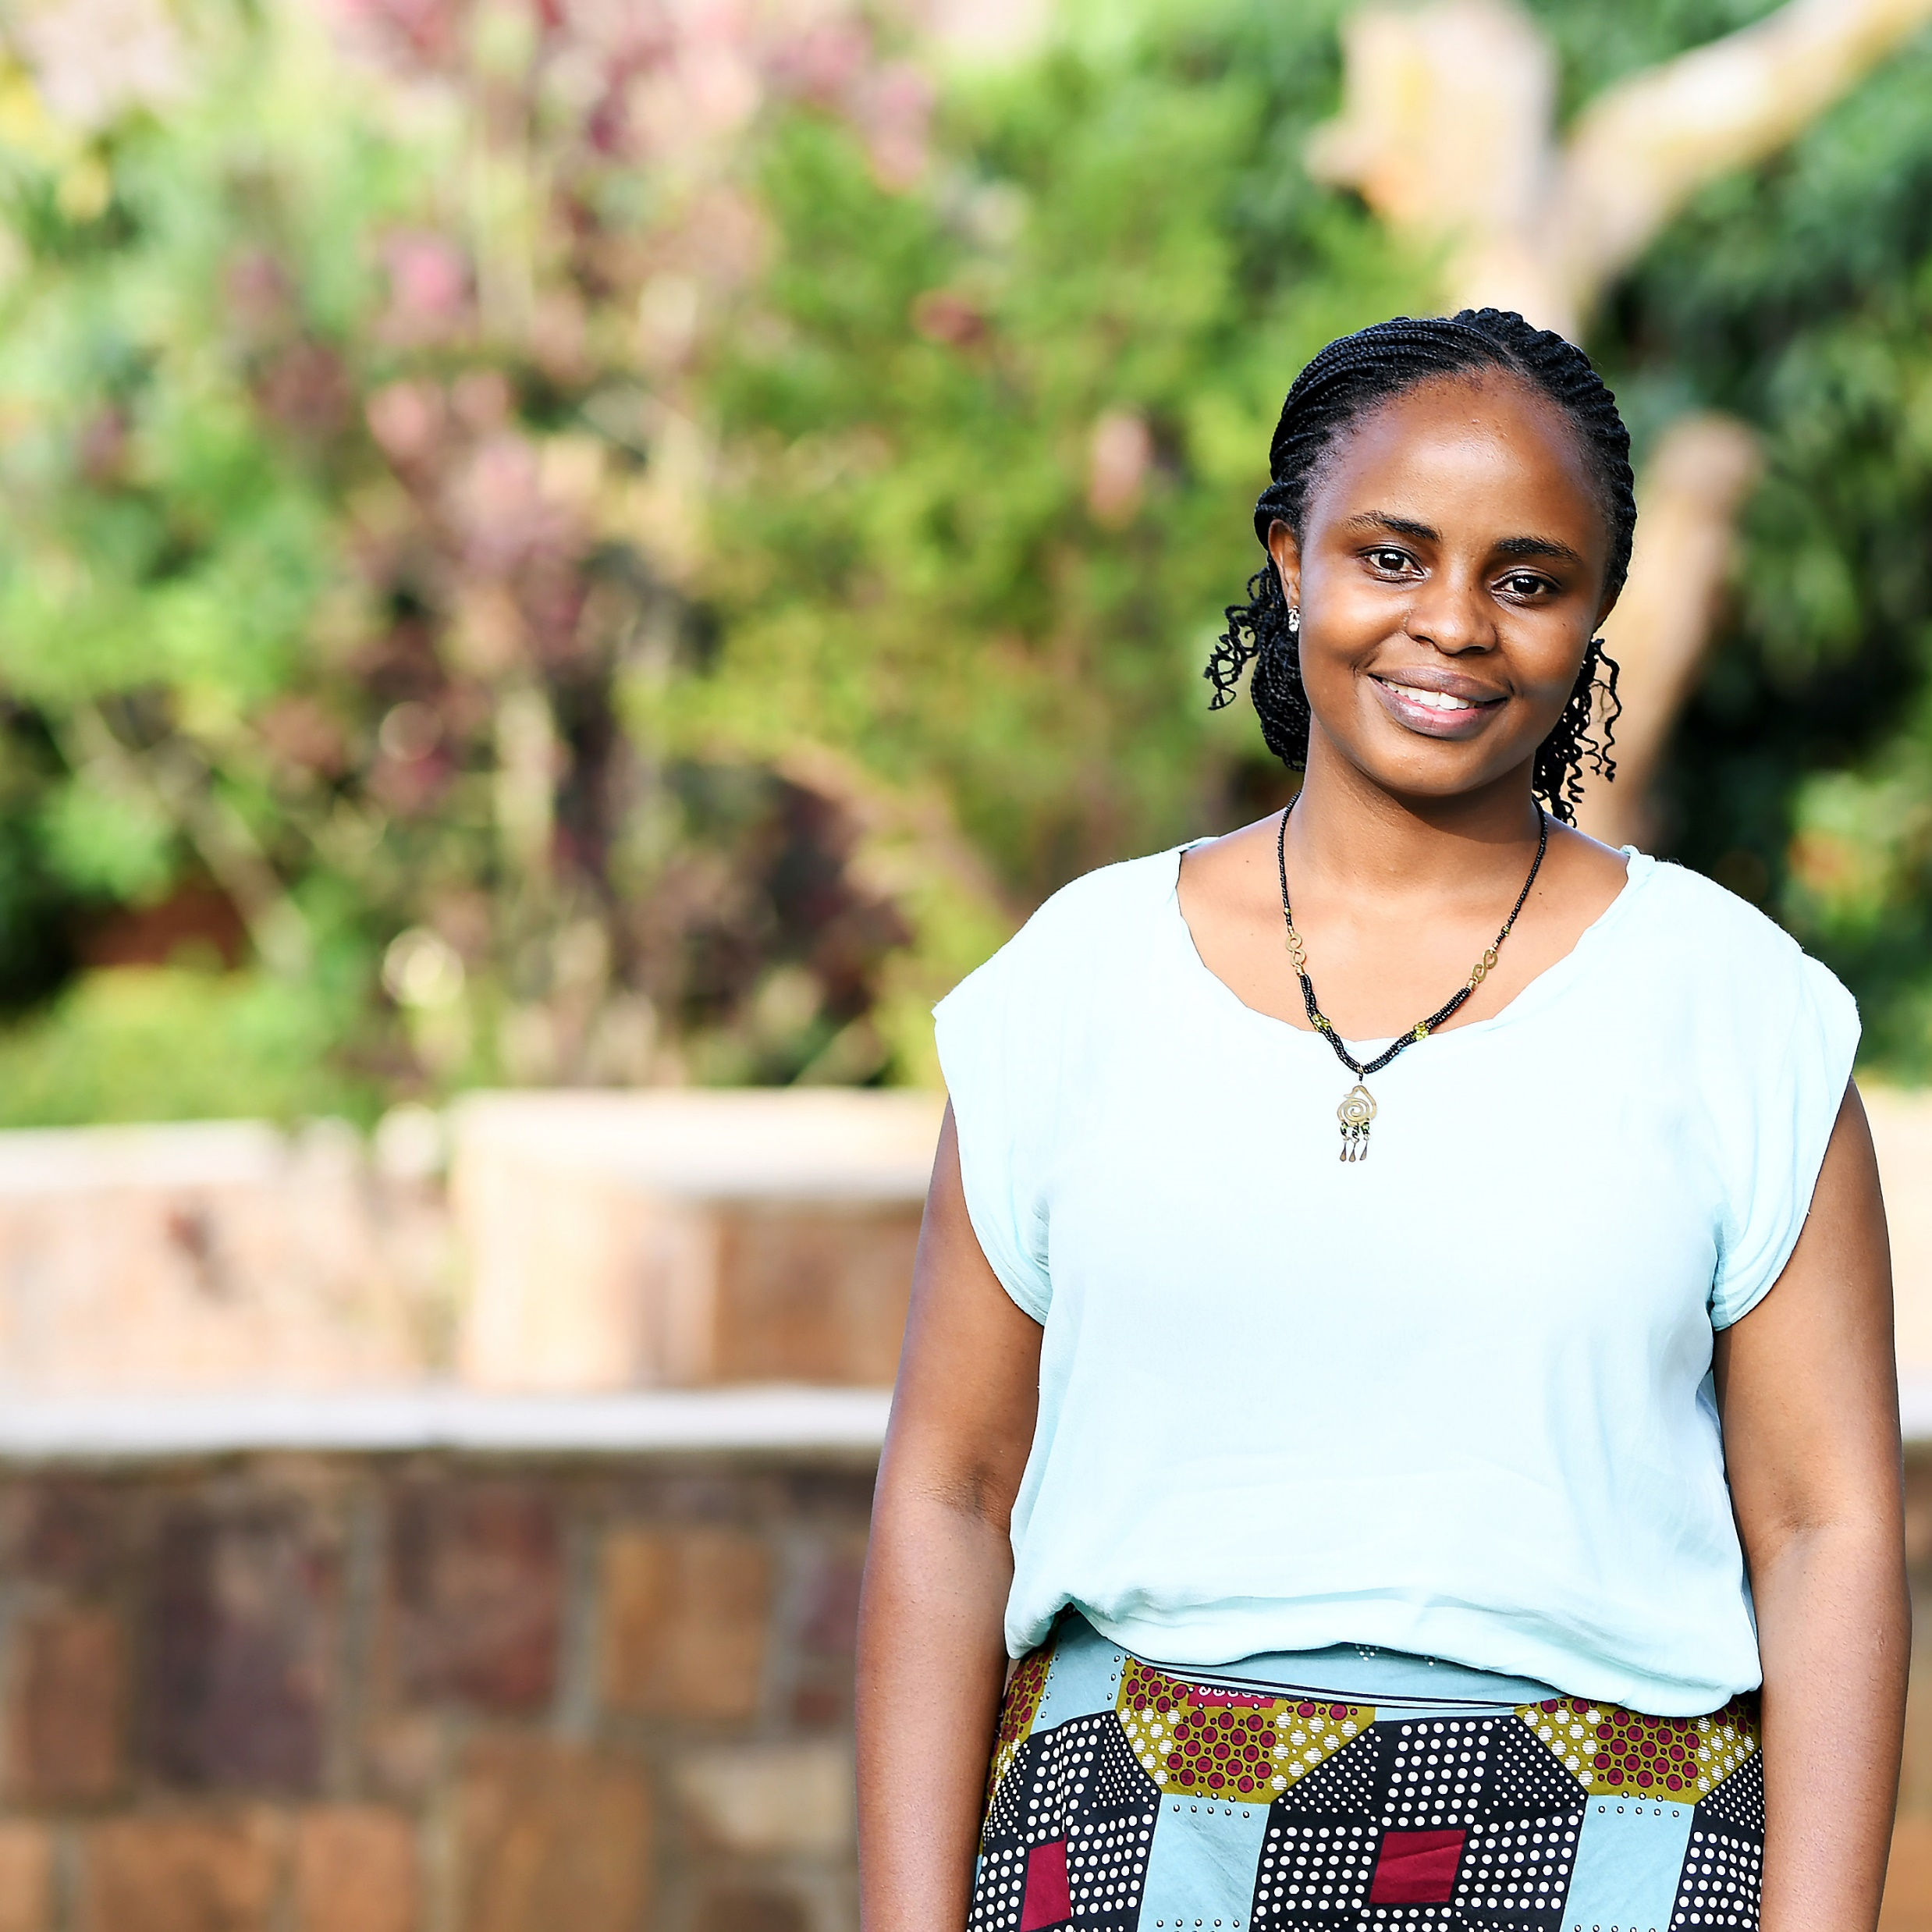
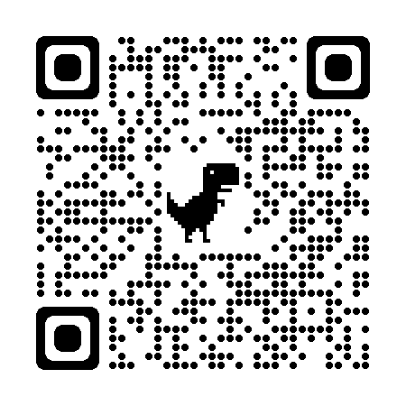
Dear, Thank you for your contribution to We hereby state that NOK is given to the Norwegian Nurses Organisation’s work to strengthen nursing organisations in Africa. Through this contribution you support the organisations in promoting nurses’ interests, negotiating on their behalf and safeguarding their rights. Date and place: Signature:
Thank you!
Read more about our work at www.nsf.no or scan the QR-code

